Slide 1





SOFTWARE ARCHITECTURE
HOME
ABOUT US
SERVICE
ONLINE EXAMINATION BERBASIS WEB
Kelompok 4
M. RIZWAN - 13020230100
START PRESENTATION

Slide 2


SOFTWARE ARCHITECTURE
HOME
ABOUT US
SERVICE
LATAR BELAKANG
Ujian masih konvensional → boros waktu & biaya
Perlu sistem CBT berbasis web dan proctoring kamera
KEBUTUHAN BISNIS
Efisiensi pelaksanaan ujian
Keamanan & integritas data
Hasil evaluasi cepat & akurat
STAKEHOLDER
Mahasiswa, Dosen, Admin, Tim TI, Pimpinan Fakultas
SCOPE
Pelaksanaan ujian web, bank soal, proctoring, auto-grading, laporan hasil

Slide 3


SOFTWARE ARCHITECTURE
HOME
ABOUT US
SERVICE
BUSINESS DRIVERS, TRADE-OFFS, TANGGUNG JAWAB
Business Drivers
Keamanan & integritas ujian
Skalabilitas ujian massal
Efisiensi penilaian & laporan
Trade-offs
Monolith vs Microservices → Microservices
Manual vs Otomatis → Proctoring Otomatis
DB terpusat vs Per Service → DB per Service
Tanggung Jawab
Architect → Desain & integrasi sistem
Developer → Implementasi & optimasi

Slide 4



SOFTWARE ARCHITECTURE
HOME
ABOUT US
SERVICE
Karakteristik Arsitektur
Availability: 99.9% uptime (minim downtime).
Security: Enkripsi data & autentikasi ganda.
Scalability: Support ≥10.000 peserta ujian serentak.
Performance: Respon API < 500 ms.
Usability: Antarmuka mudah digunakan (95% user success rate).

Slide 5

SOFTWARE ARCHITECTURE
HOME
ABOUT US
SERVICE
GAYA ARSITEKTUR
Dipilih: Hybrid → Microservices + Event-Driven Architecture
Alasan:
Microservices → Modular & scalable per layanan.
Event-Driven → Mendukung real-time proctoring & logging.
Komponen Utama:
API Gateway
Exam Service
Question Bank Service
Proctoring Service
Result & Analytics Service
Message Broker

Slide 6

SOFTWARE ARCHITECTURE
HOME
ABOUT US
SERVICE
PRINSIP ARSITEKTUR
Modularitas:
Setiap service memiliki fungsi spesifik (Low Coupling, High Cohesion).
Separation of Concerns:
Pemisahan logika: ExamService, EvaluationService, NotificationService.
SOLID Principles:
SRP (Single Responsibility): Tiap service hanya punya satu tanggung jawab.
DIP (Dependency Inversion): Memudahkan pengembangan tipe ujian baru.
Prinsip ini menjaga sistem tetap fleksibel, mudah diuji, dan dapat dikembangkan.

Slide 7

SOFTWARE ARCHITECTURE
HOME
ABOUT US
SERVICE
POLA ARSITEKTUR & DESIGN PATTERN
Pola Arsitektur:
Backend for Frontend (BFF): Backend terpisah untuk peserta & proctor.
CQRS: Pisahkan proses tulis (Command) & baca (Query) untuk performa optimal.
Design Pattern:
Factory Pattern: Membuat berbagai tipe ujian (Regular, Adaptive, Practice).
Observer Pattern: Event-driven untuk notifikasi & analitik otomatis.
Strategy Pattern: Penilaian fleksibel (Objective, Essay, Adaptive).

Slide 8


SOFTWARE ARCHITECTURE
HOME
ABOUT US
SERVICE
KESIMPULAN
Arsitektur: Microservices + Event-Driven
Keunggulan: Skalabilitas, modularitas, keamanan tinggi.
Implementasi bertahap: Core → Integrasi → Optimasi.
Metrics Keberhasilan:
Uptime ≥ 99.9%
Response ≤ 500 ms
0 Data Breach
Kepuasan pengguna ≥ 90%

Slide 9
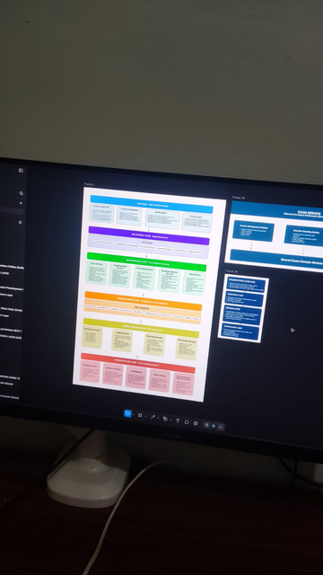
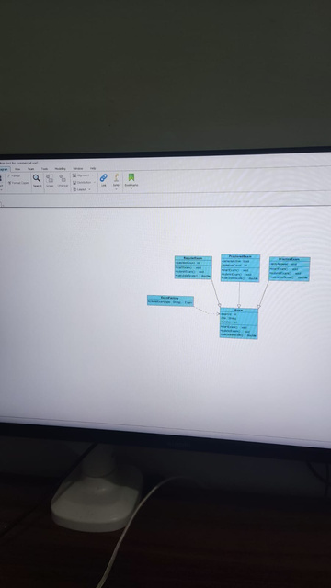
SOFTWARE ARCHITECTURE
HOME
ABOUT US
SERVICE
DOKUMENTASI

Slide 10

SOFTWARE ARCHITECTURE
HOME
ABOUT US
SERVICE
Pembagian Tugas:
M. RIZWAN (SEMUANYA)
THANK YOU
FOR LISTENING
SEE YOU NEXT TIME

